Slide 1

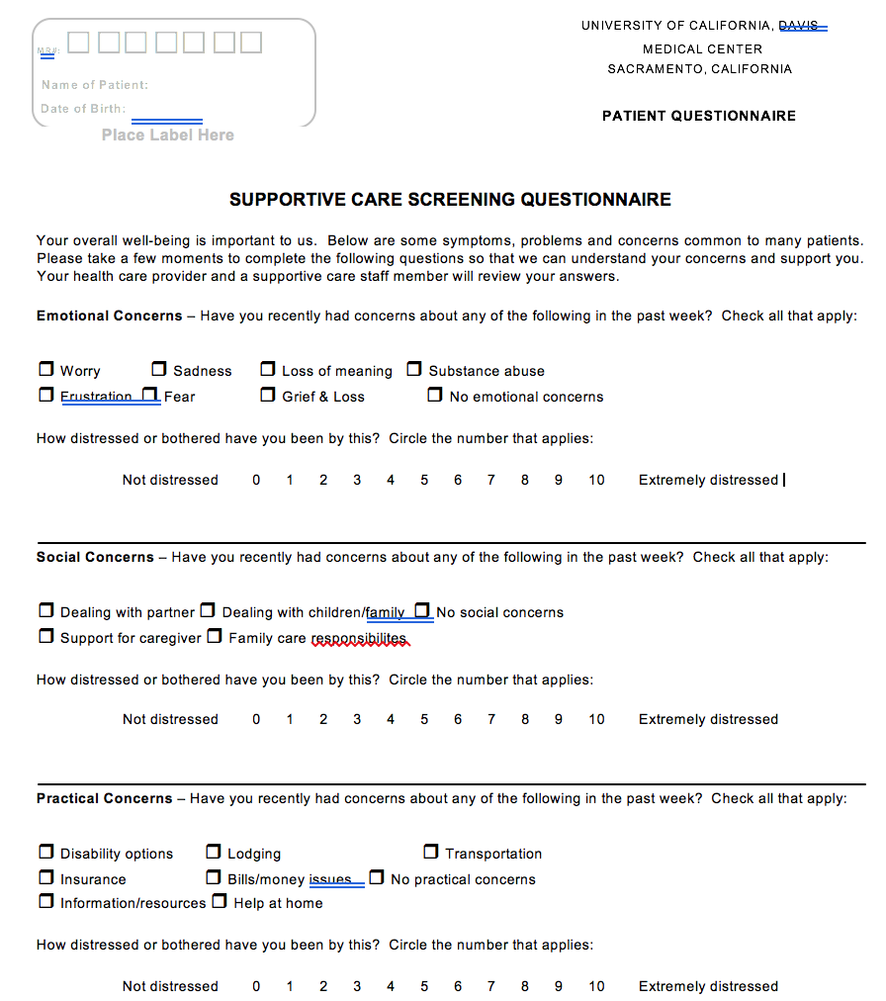
Prevalence of Sexual Health and Intimacy Concerns in Patients Referred to a Comprehensive Cancer Center
Kate Hanel BS, Sarah Watson MD, Angela Usher LCSW, OSW-C, Vanessa Kennedy MD
University of California Davis Health, Sacramento, California
INTRDUCTION
RESULTS
RESULTS
CONCLUSIONS
Treatments offered to women diagnosed with gynecological cancer have significant sexual and intimacy side effects
Baseline prevalence of sexual health and intimacy concerns for patients undergoing cancer treatment is not well described
Understanding sexual health concerns of women undergoing cancer treatment can aid in developing patient centered interventions that holistically address the effects of cancer treatment
Describe prevalence of sexual health and intimacy concerns in patients presenting for evaluation at UC Davis comprehensive cancer care center
Describe demographic and disease characteristics of patients with sexual health and intimacy concerns
Categorize additional common concerns among newly diagnosed cancer patients
All Survey Respondents
Gynecological Cancer Patients
This study design was aimed to determine the incidence of SHIC, with particular interest in categorizing patients diagnosed with gynecologic cancer.
Our results describe an incidence of 14% of gynecologic cancer patients with SHIC. This result is lower than many other studies, which describe an incidence of up to 50% SHIC, depending on study design. This discrepancy may be due to language in the survey used.
This study was designed with the intent of developing a quality improvement project to support patients with SHIC concerns, but we found that the most prominent concerns for patients were emotional and financial.
We did not find a conclusive connection between prior treatment and patients who reported SHIC
Furthermore, this study is small and is fundamentally limited by sample size.
STUDY OBJECTIVES
LOOKING FORWARD
DESIGN & METHODS
Re-evaluate patients over time to determine whether or not treatment for cancer predisposes patients to developing SHIC. We hypothesized that extent and duration of treatment may contrinute to SHIC but did not have sufficient survey responses to demonstrate this connection.
Evaluate need for additional support to these patients based on their demonstrated emotional concerns. This could potentially include support groups or additional offering of specific psychologic support
Additionally explore what resources or discussions would improve patient duress caused by patient financial concerns. This could include improved support with insurance or financial counseling
Retrospective cross sectional study of women referred to Comprehensive Cancer Center who completed Supportive Care Screen Survey between April 1 2015 and March 31 2016 following IRB approval
Survey evaluated potential categories of patient concern including emotional, social, practical, and health concerns
  Sexual Health and intimacy concerns (SHIC) were evaluated as health concern
  Supportive Care Screen consisted of the National Comprehensive Cancer Networks’ (NCCN) Distress Thermometer and Problem Checklist, and the Patient Hospital Questionnaire 2 (PHQ-2).
Responses to survey were categorized, and further information regarding patient age, smoking status, BMI, race, insurance, cancer type, stage, and date of diagnosis was gleaned from EMR patient chart review
Scoring based on 10 point distress scale
14% SHIC concerns
Inconclusive correlation between SHIC and prior treatment
REFERENCES
Donovan KA, Grassi L, McGinty HL, Jacobsen PB. Validation of the distress thermometer worldwide: state of the science. Psychooncology [Internet]. 2014 Mar [cited 2016 Sep 18];23(3):241–50
Coady D, Kennedy V. Sexual Health in Women Affected by Cancer: Focus on Sexual Pain. Obstet Gynecol [Internet]. 9000;Publish Ah.
DeSimone M, Spriggs E, Gass JS, Carson S a, Krychman ML, Dizon DS. Sexual dysfunction in female cancer survivors. Am J Clin Oncol [Internet]. 2014 Feb [cited 2014 Oct 17];37(1):101–6.
Hill EK, Sandbo S, Abramsohn E, Makelarski J, Wroblewski K, Wenrich ER, et al. Assessing gynecologic and breast cancer survivors’ sexual health care needs. Cancer [Internet]. 2011 Jun 15
Incidence of SHIC: 5%
  Breast
  GI
  Endocrine
  Gynecologic
ACKNOWLEDGMENTS
64.7% reported financial concerns
The project described was supported by the Na5onal Center for Advancing Transla5onal Sciences, Na5onal Ins5tutes of Health, through grant number UL1 TR001860. The content is solely the responsibility of the authors and does not necessarily represent the official views of the NIH

